Slide 1

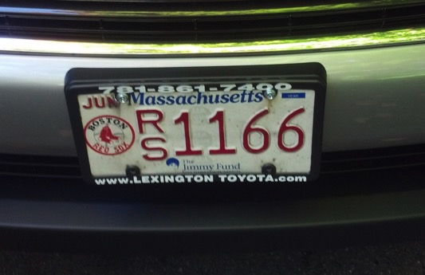

Reflections & Ruminations
20+ Year Patient Safety Journey
Jim Conway
Adjunct Faculty (ret.), HSPH
Trustee, Winchester Hospital/LHS
Trustee, Lahey Health System
jbconwaywoburn@gmail.com

Slide 2
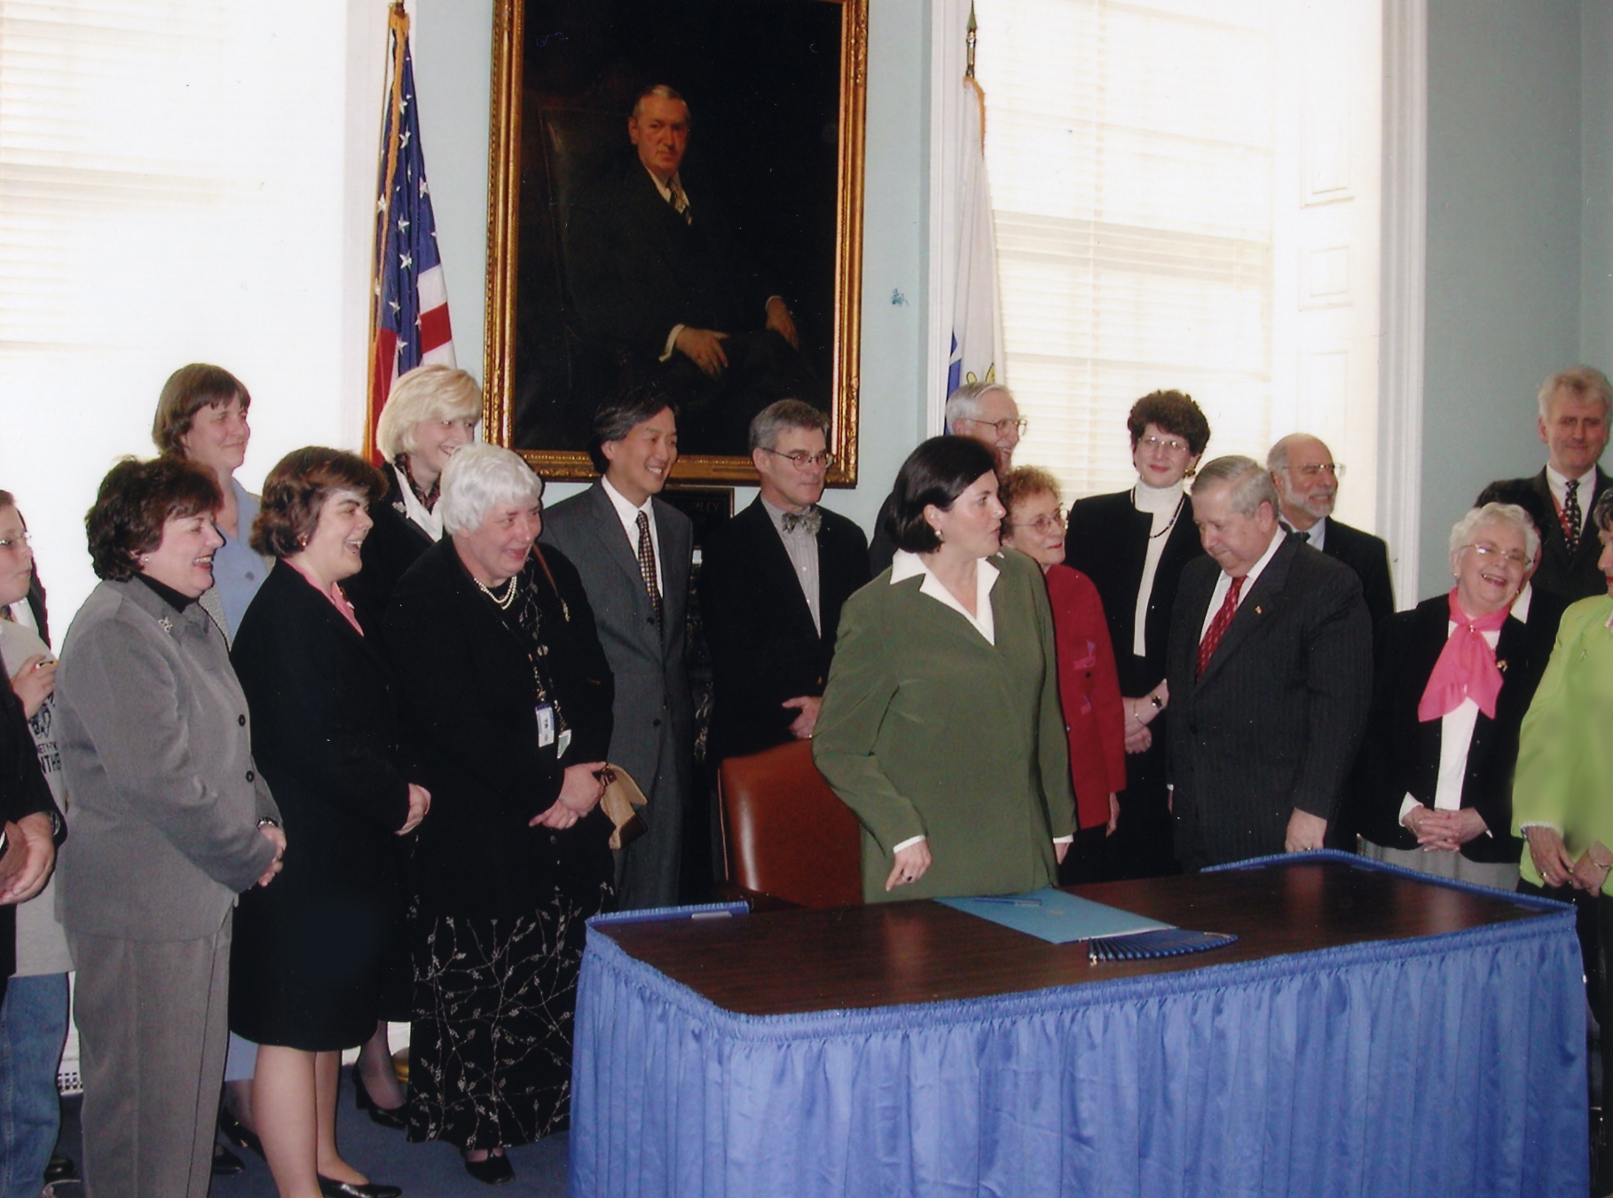



For your service to your patients, families, staff, and communities.

Slide 3
Outline
Reflections and Ruminations
Reflections Over Twenty Years
Improvement Ruminations
Creative Tension, etc.
Key Learning: Betsy Lehman
Arrogance Of Excellence
Never Worry Alone
Engaging at Every Level
Interaction for Improvement
Scope: Problem /Opportunity
Systematic Improvement
Boards on Board
Respectful Management
Culture / Teamwork
Safety About Staff Too
Respect
PS: More Than Inpatient
PS: Essential Part of Value
Struggles: Field & Classroom
  Most Change Fails
  Elegant Silos
  Spray And Pray
  Waterfall, Projectitis
  Try To Do Everything…

Slide 4
… a personal story followed by
… a professional story

Slide 5
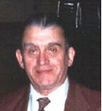
“Jim, you better come home. I think dad is dead”
August 19, 1980
Avoidable death at 73
John Conway
5
5

Slide 6



Important Early Pre-Work
Patient & parent partnership “No force…”
Risk Management Rounds: Better together...

Slide 7
Creative Tension
Creative tension comes from clearly seeing where we want to be, our 'vision', and telling the truth about where we are, our 'current reality’. The gap between the two generates a natural tension.
The Fifth Discipline: The Art and Practice of the Learning Organization Peter Senge, 1990 - 1st edition, 1994 - paperback edition, xxiii, 413 p., ISBN 0-385-26095-4

Slide 8
Key DFCI Learning After the Betsy Lehman Tragedy
Burden
Responsibility
Power

Slide 9

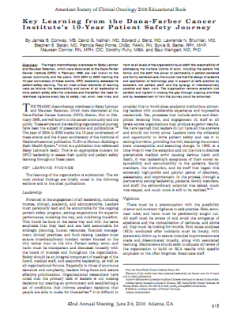
Key Learning
The responsibility and power of all leadership [trustee, clinical and administrative] over safety
The need for relentless vigilance to safety, risk, error, near-miss, harm
Addressing the multiple victims of error
The crucial role the design of systems and application of technology play in support of safe practice by excellent staff
The synergy of interdisciplinary practice and team work
Patient and Family Centered Care
http://www.asco.org/ASCOv2/Education+%26+Training/Educational+Book?&vmview=edbk_detail_view&confID=40&abstractID=615

Slide 10
Our systems are too complex to expect merely extraordinary people to perform perfectly 100% of the time. We as leaders must put in systems that support safe practice.

Slide 11
Arrogance of Excellence
Risk of Great Organizations
Focus only on the great stuff and forget to confront the suffering, harm, tragedy, and waste

Slide 12
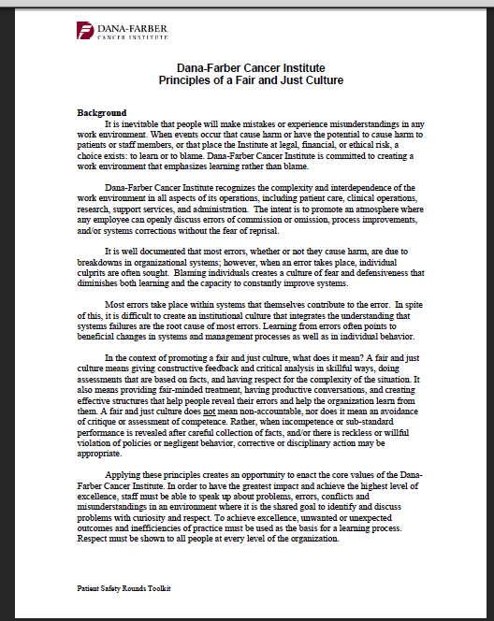
Organization:
Fair and Just Culture
One that values fair, objective and explicit decision rules for determining accountability and culpability subsequent to an adverse event.
Connor, M., Duncombe, D., Barclay, E., Bartel, S., Borden, C., Gross, E., Miller, C. and Ponte, P.R., 2007. Creating a fair and just culture: One institution's path toward organizational change. The Joint Commission Journal on Quality and Patient Safety, 33(10), pp.617-624.

Slide 13
“Aren’t you EVER Satisfied?”
“No!”
High Reliability Organizing Weick & Sutcliffe
Preoccupation with failure
Reluctance to simplify interpretations
Sensitivity to operations
Commitment to resilience
Deference to expertise
http://www.pipsqc.org/BlogEvents/PIPSQCBlog/tabid/89/EntryId/34/Leadership-and-Pre-Occupation-With-Failure.aspx
Weick, K. E., Sutcliffe, K. M., & Obstfeld, D. (1999). Organizing for high reliability: Processes of collective mindfulness. In B. M. Staw & L. L. Cummings (Eds.), Research in organizational behavior, vol. 21 (pp. 81–123). Greenwich, CT: JAI Press, Inc.

Slide 14
Never Worry Alone
Susan Block, MD
Who can we invite into this discussion for a better outcome?

Slide 15
Engaging At Every Level: Especially at the Front Line
The higher you get to the top, the less you know how the work really gets done

Slide 16
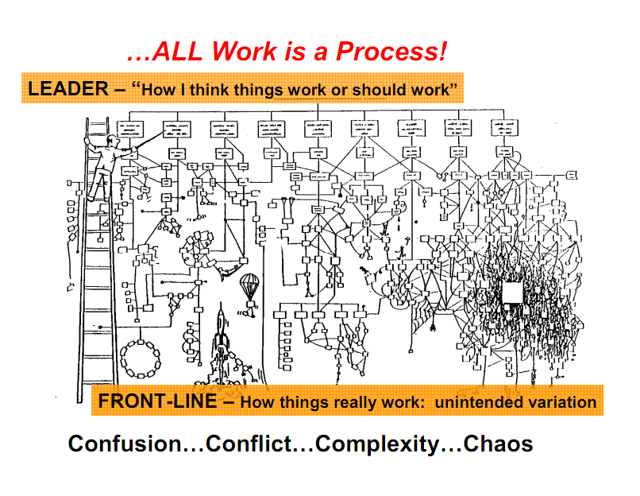
Zeev slide
16

Slide 17
Set the Expectation
Position People for Success
Hold Them Accountable
Without clarity of expectations,
deviance can’t stand out.
Roger Berkowitz,
Trustee, DFCI
CEO, Legal Sea Foods

Slide 18
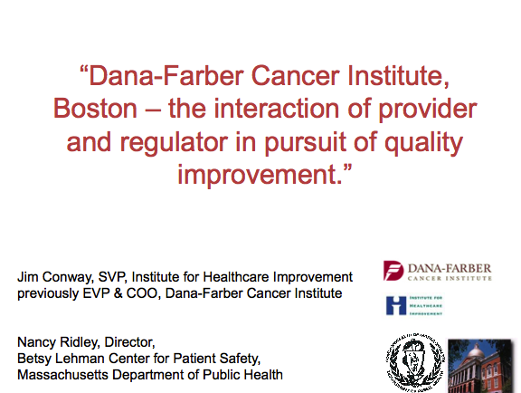
Presentation to CMS
... the interaction…

Slide 19
IHI Framework for Leadership for Improvement
Setting Direction: Mission, Vision and Strategy
Systematic Improvement
Making the future attractive
PULL
PUSH
Changing the old
Ideas
Will
Execution
Establish the Foundation

Slide 20
Built off IHI Boards on Board Plank
2015: Some Recommended Practices
Setting aims
  Know your aims
  Strategic & compliance
Getting data and hearing stories
  Focus is on all harm/ not tip
  Meet patient, family, community
  Find canaries: readmissions
  Be transparent
  Understand variation
  Get out and about organization
Establishing and monitoring system-level measures
  Respect but don’t get lost in core and process measures
  Value focus: clinical, financial, service, experience “dance”
  Measure & manage across care continuum
Changing the environment, structures, processes, and culture
  Set / broadcast expectations
  Allocate significant time to quality, safety, risk
  High reliability systems
  Measure and evolve cultural variation
  Promote team building
  Respectfully manage serious adverse events
  Engagement in credentialing
Learning
  Conduct applied in-service and continuing education
Establishing executive accountability
  Clinical, financial, service, experience outcomes

Slide 21
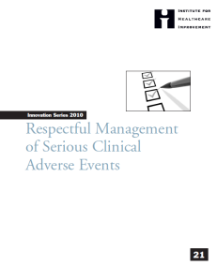
Respectful Management of Serious Clinical Adverse Events
I was treated with RESPECT

Slide 22

In the Aftermath of Harm…
Patient, Family, Staff, Organization
22
Empathy
Disclosure
Support
Assessment
Apology
Resolution
Learning
Improvement
http://tinyurl.com/IHIEffectiveCrisisMgmt

Slide 23
Creating Awareness is Just the Start
Respectful Mgmt. White Paper
> 70,000 views of content
> 30,000 downloads
Slow movement in the field

Slide 24
Culture / Teamwork
The strongest predictor of clinical excellence: caregivers feel comfortable speaking up if they perceive a problem with patient care.
Michigan Keystone Initiative

Slide 25
Culture Is Related To Clinical & Operational Outcomes
  Medication errors
  Back injuries
  Patient satisfaction
  Nurse turnover & absenteeism
  AHRQ Patient Safety Indicators
  Nurse satisfaction
  Urinary tract infections
  Needle sticks
  Re-admissions
  Malpractice claims ...and more.
  Useful References for Culture-to-Outcomes Linkage:
Hansen et al. (2011)
Curry et al. (2011)
Pettker et al. (2009)
Singer et al. (2009)
Vogus & Sutcliffe (2007)
Mark et al. (2007)
Naveh et al. (2006)
Hofmann & Mark (2006)
Katz-Navon et al. (2005)
Courtesy A. Frankel MD

Slide 26
How Culture is Imbedded
Primary
What leaders do, pay attention to measure and reward on a regular basis
How leaders react to critical incidents and organizational crises incidents and organizational crises
Deliberate role modeling, teaching and coaching
Observed criteria by which leaders allocate rewards and status
Observed criteria by which leaders recruit, select, promote, retire and terminate organizational members
E. Schein. Organizational Culture and Leadership. 1994
Publicly Verifiable

Slide 27
Safety Is About Staff Too!

Slide 28
Employee Workplace Illness/Injury
Harm Bubble
GOAL: 0
There have been
304 Employee Illnesses/Injuries reported through FY 2013. 78 employees were seriously harmed*.
*Serious Harm is defined by Mass Serious Reportable Events
(i.e. lost work time, work restrictions, follow up testing required related to injury)
Bloodborne
Pathogen/Sharps
Exposure
36
Material Handling
25
Challenging
Person/Situation
34
Employee Safety
FY 2013 (Entire)
Fall/Slip/Trip
86
Struck or
Injured by
47
Patient Handling
48
Other/Misc
28
Notes:
28

Slide 29
Respect
At the end of the day…
NOTHING is more important

Slide 30
RUMINATIONS

Slide 31
Patent Safety:
More than In-Patient
Across the Continuum
Into the Home & Community

Slide 32
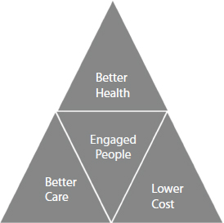



Quality and Patient Safety
Essential Parts of the
Value Equation

Slide 33
Struggles Reported in the Classroom and the Field
Change Failure
Siloes
Spray & Pray
Waterfall
Projectitis
Focus

Slide 34

Most Change Fails
Everyone

Slide 35
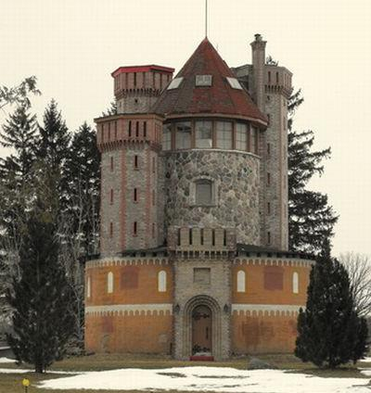
Elegant Silos

Slide 36
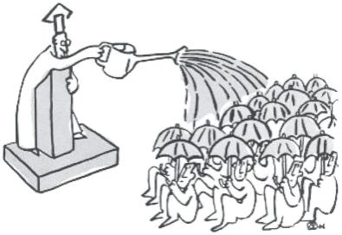
Spray and Pray

Slide 37

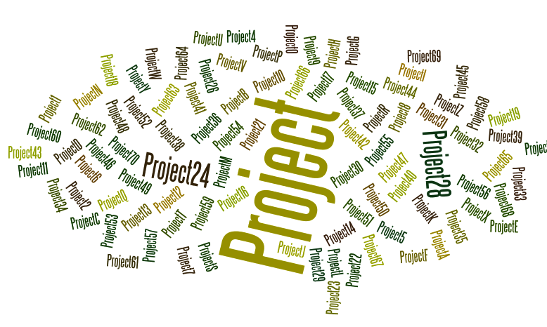
The Waterfall
Projectitis
“Every day I come to work I feel like I’m sitting at the bottom of a waterfall. The stuff keeps coming and coming”
Staff RN

Slide 38
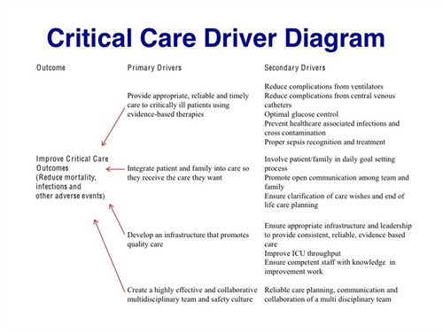
If you try to do everything, you could accomplish nothing.
Focus
Align
Prioritize
Driver Diagram
http://www.ihi.org/education/ihiopenschool/resources/Pages/Activities/GoldmannDriver.aspx

Slide 39

Closing on
Professional and Personal Note
For all we have accomplished together...
... There is so much more to learn and do
http://www.aarp.org/health/conditions-treatments/info-2016/hospital-medical-mistakes-photos.html#slide1

Slide 40
To do things differently, we must see things differently. When we see things we haven’t noticed before, we can ask questions we didn’t know to ask before.
John Kelsch, Xerox
Quality Health Care In America Project

